Slide 1
Java 11 String Class Improvements
momedaram

Slide 2
Java 11 Improvements for String Class:
Introduced 6 new String Methods.
isBlank()
Lines()
repeat()
strip()
stripLeading()
stripTrailing()

Slide 3
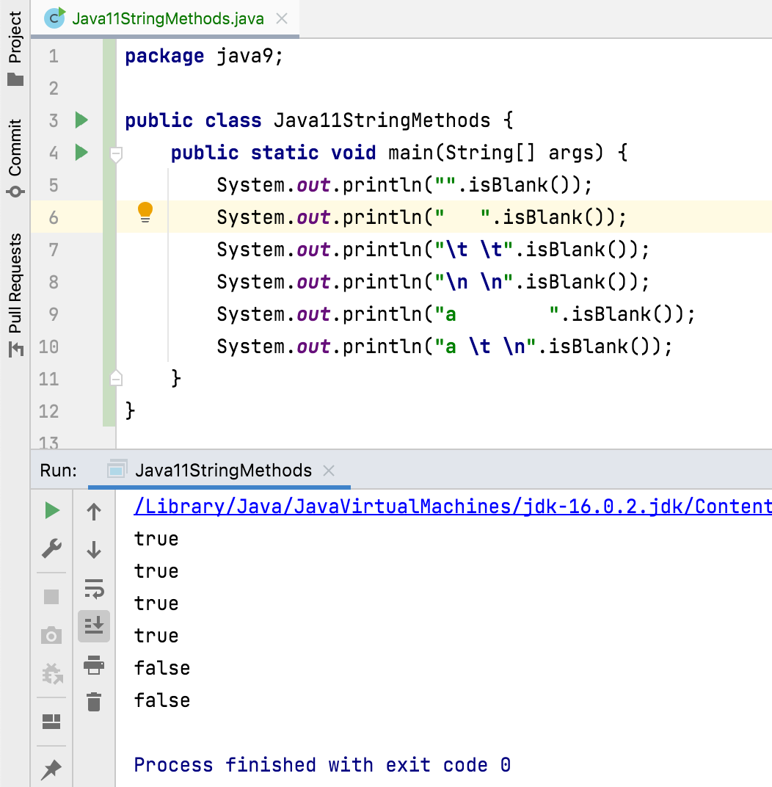
1. isBlank() :
we can use this method to check whether given string is blank or not. A string is said to be blank if it is empty or contains only white spaces.

Slide 4
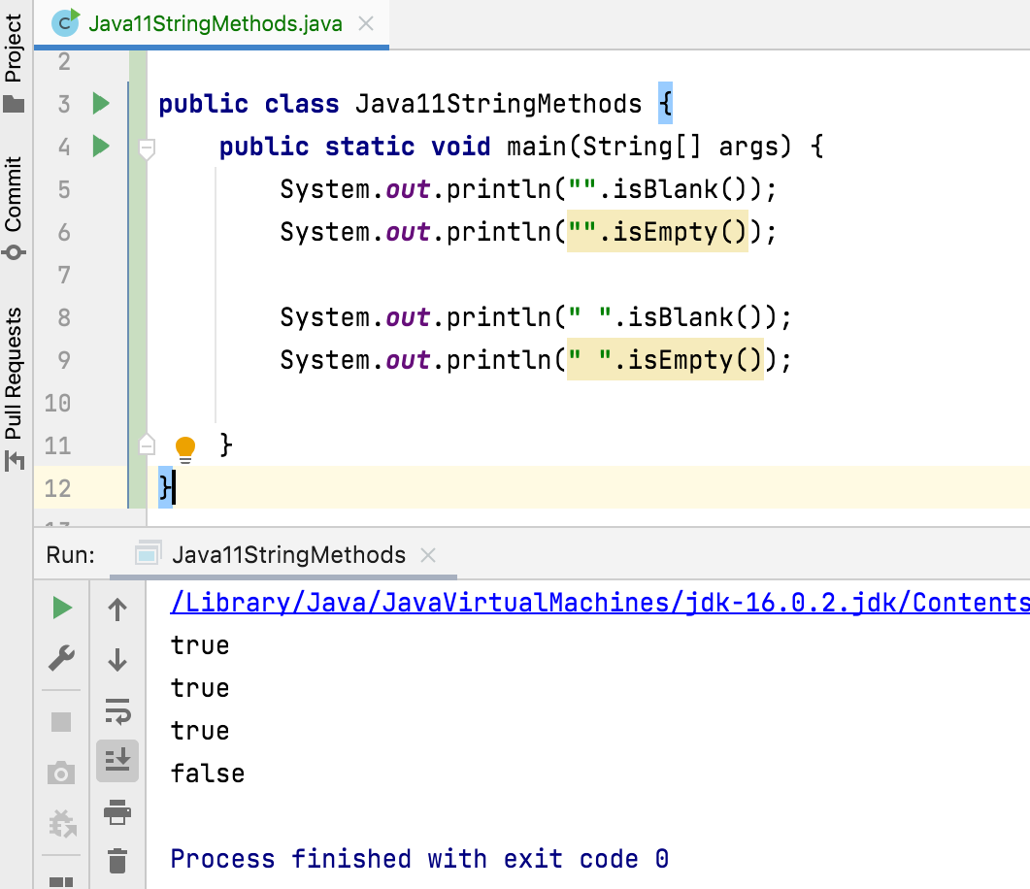

Slide 5
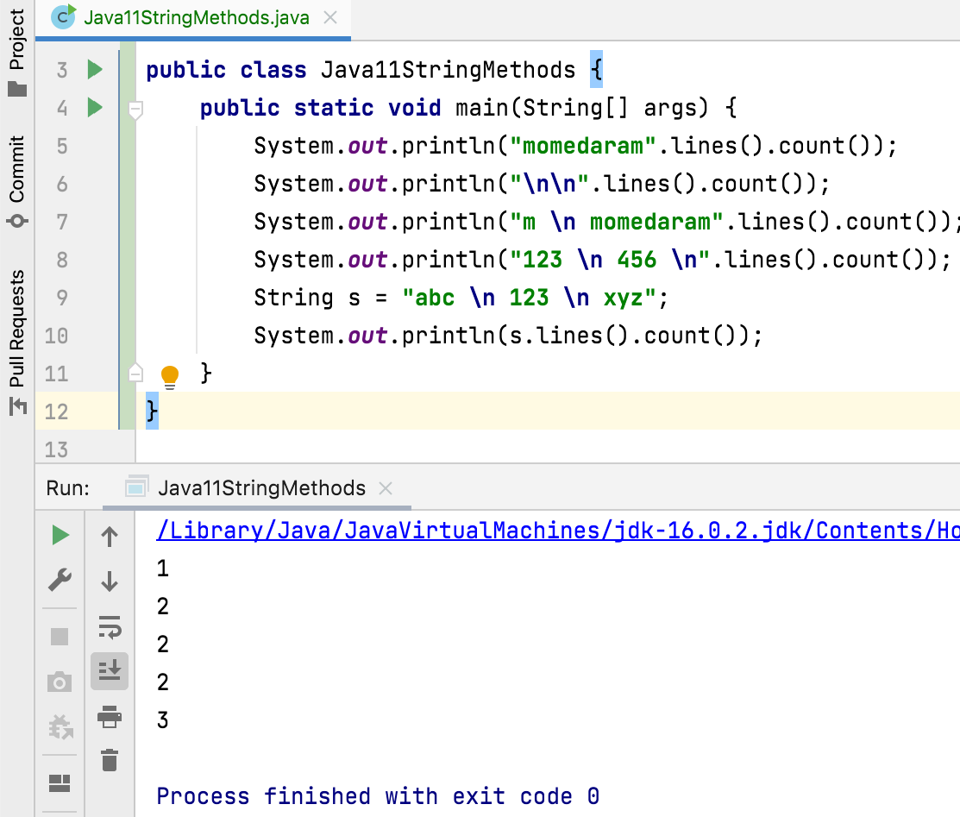
2. Lines()
This method returns a stream of lines extracted from the given string. A line can be defined as a sequence of zero or more characters followed by a line terminator(\n).

Slide 6
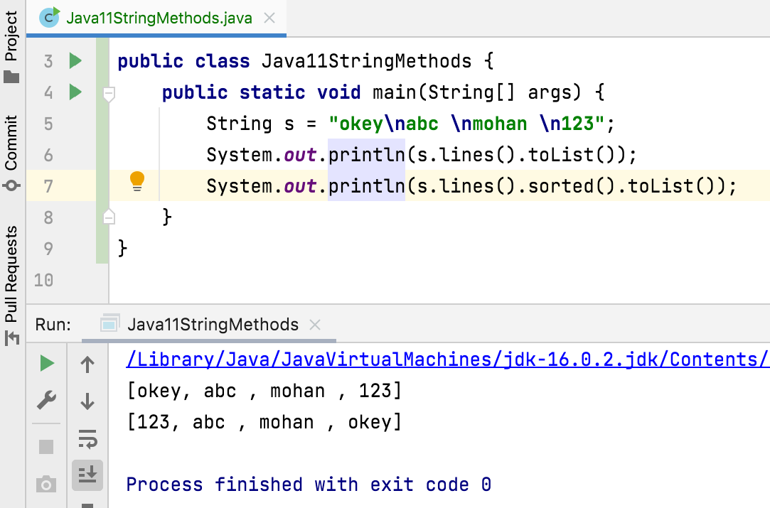

Slide 7
3. public String repeat​(int count): Returns a string whose value is the concatenation of this string repeated count times.
If this string is empty or count is zero then the empty string is returned.
This method may throw IllegalArgumentException - if the count is negative.

Slide 8
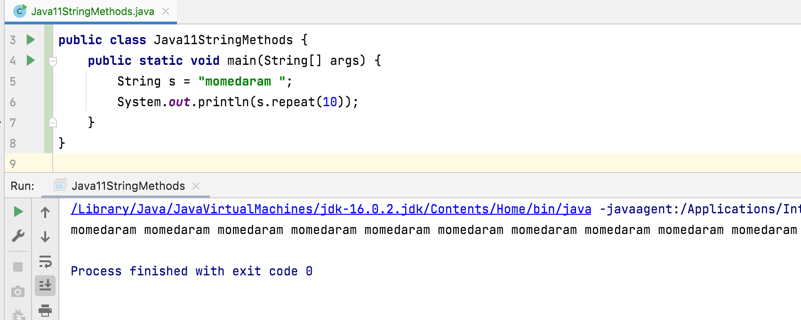

Slide 9
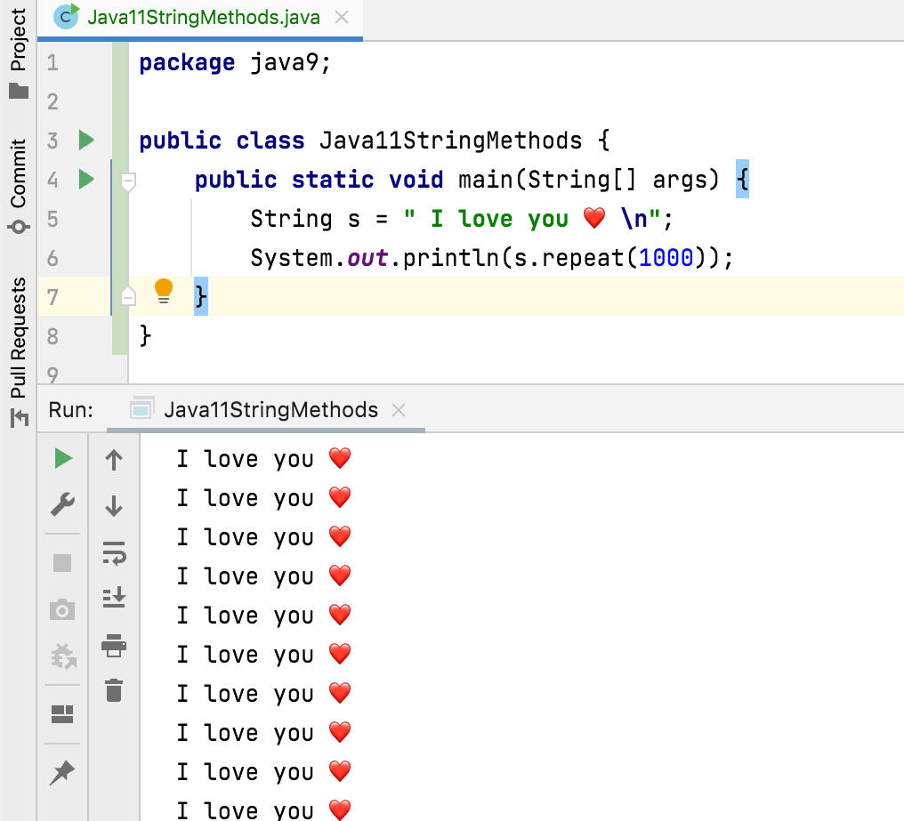

Slide 10
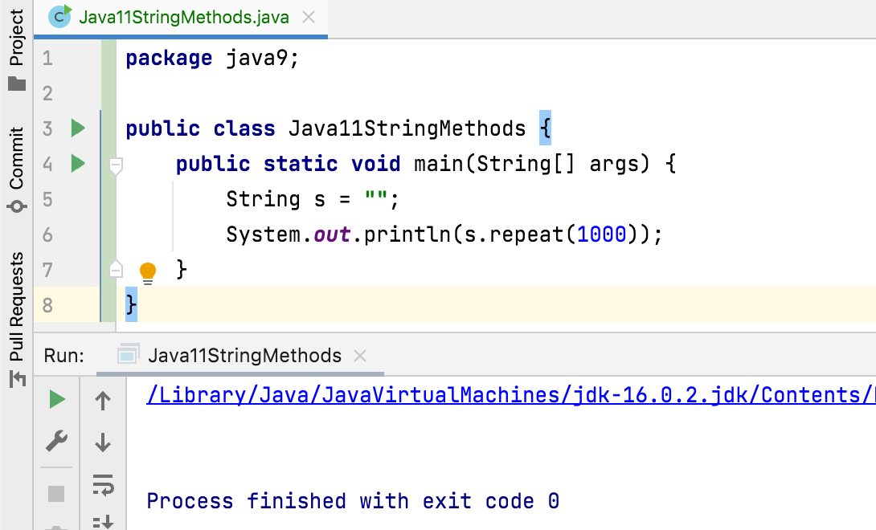
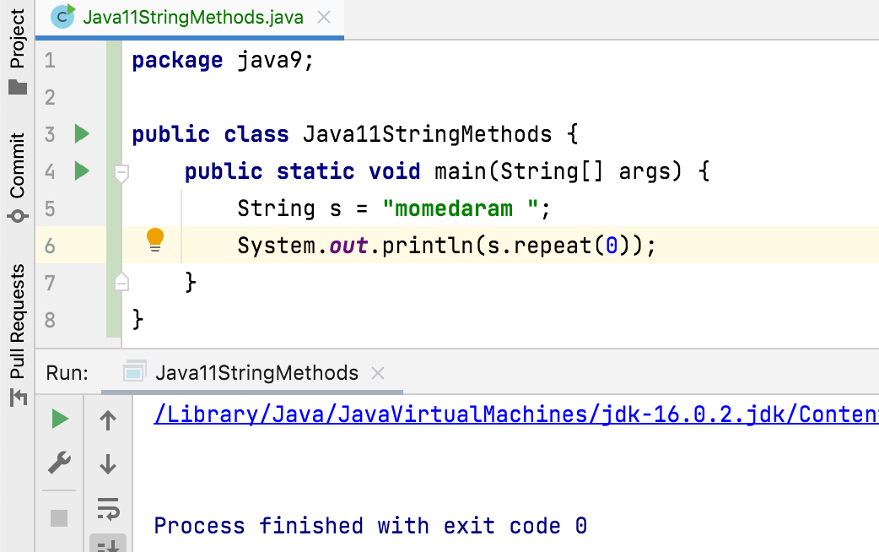

Slide 11
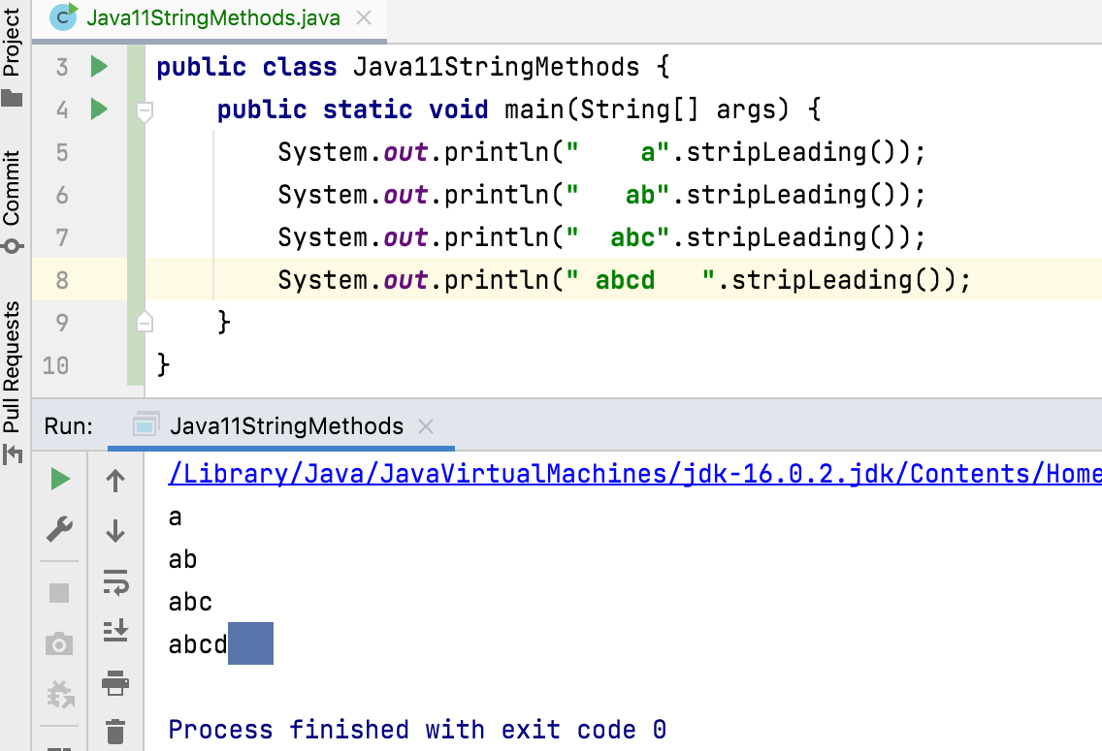
4. public String stripLeading() Returns a string whose value is this string, with all leading white space removed.
If this String object represents an empty string, or if all code points in this string are white space, then an empty string is returned.

Slide 12
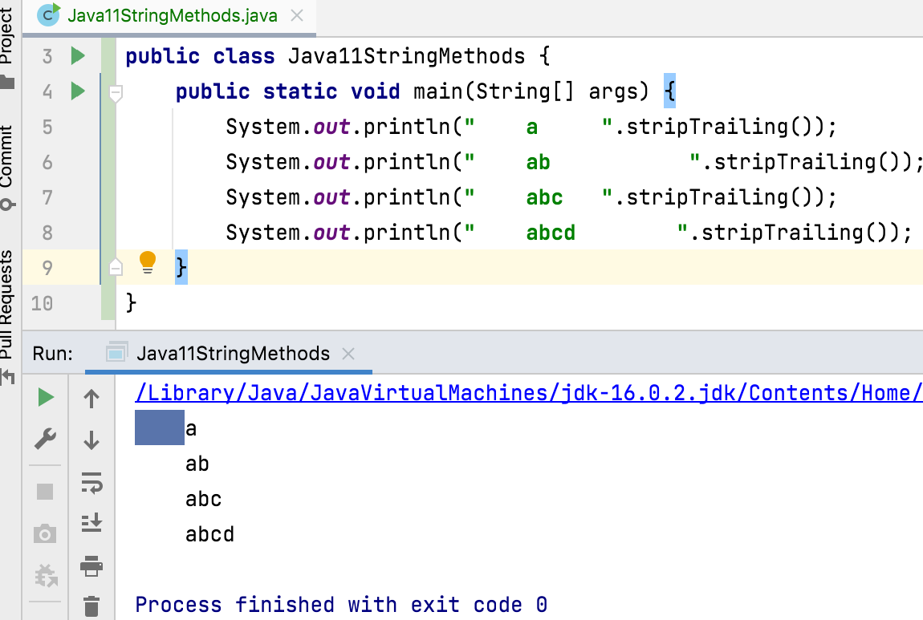
5. public String stripTrailing() Returns a string whose value is this string, with all trailing white space removed. If this String object represents an empty string, or if all code points in this string are white space, then an empty string is returned.

Slide 13
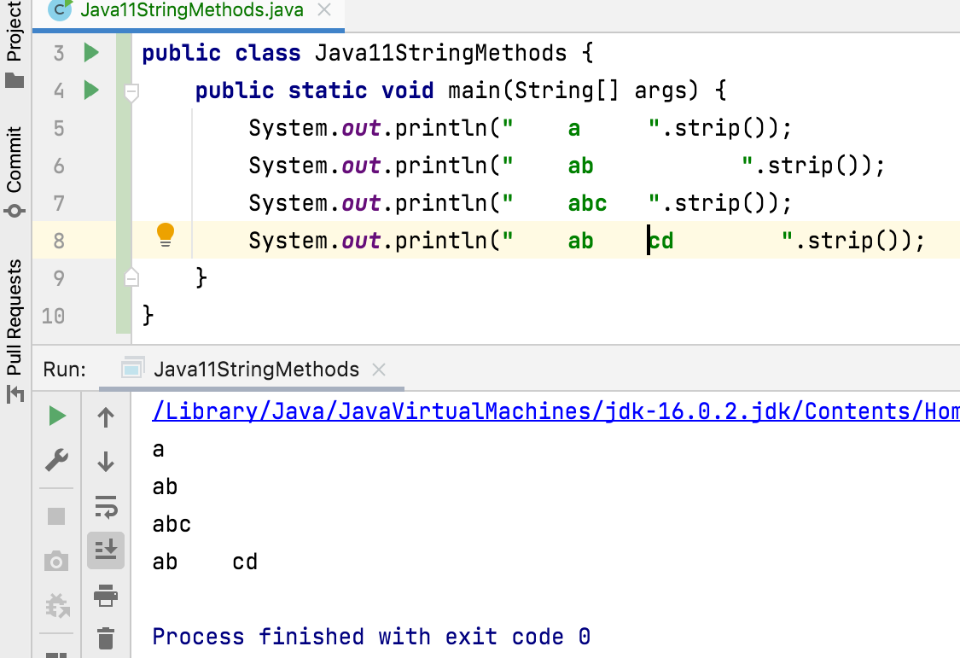
6. public String strip() Returns a string whose value is this string, with all leading and trailing white space removed.
If this String object represents an empty string, or if all code points in this string are white space, then an empty string is returned.

Slide 14
What is the difference between trim() and strip() ?
strip() is "Unicode-aware" evolution of trim().
trim() removes only characters <= U+0020 (space);
strip() removes all Unicode whitespace characters.
Character.isWhitespace(char c)

Slide 15
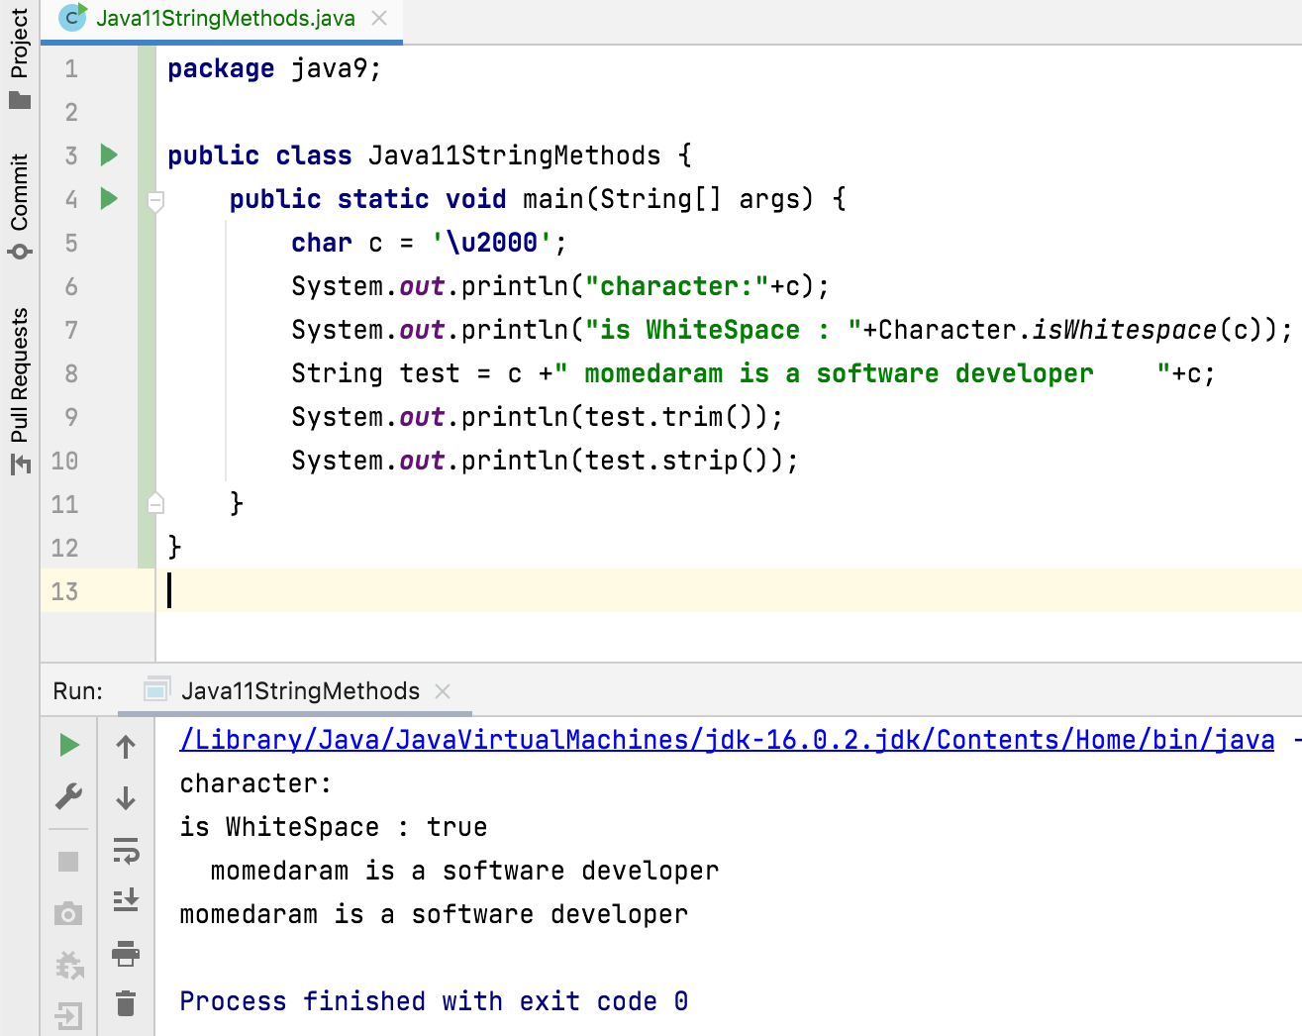


Slide 16
Thank You !
momedaram

